Slide 1
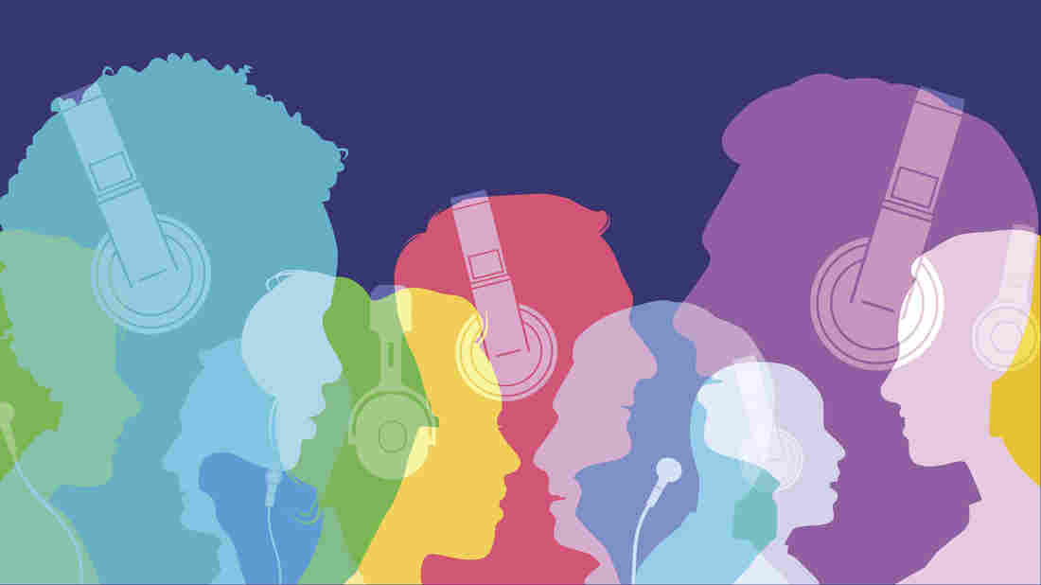

language used in the advertising & Sentiment Analysis
Group 12
Team Members
Mona Albalawi
Qiang Zhou
Yagna Ganesh
Mohammed Baaqeel
Vinod Raj Balraj
Yunxuan Hu

Slide 2
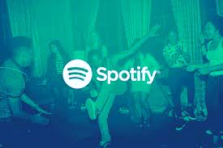
AGENDA
1. Motivation
2. Problem statement
3. Why Spotify?
4.Methodology
5. Analysis and Findings in R
6. Google trends & Hashtag trends
7. Limitations & Conclusion

Slide 3
Motivation
Customers rarely contemplate the nature of advertising as a form of discourse or as a mechanism of language use, which is rather complex from the linguistic point of view.
Simply put, advertising presents numerous examples of persuasive texts within contemporary culture; It can be found in numerous forms, such as billboards, flyers, trailers, sky-writings, brochures, logos, and viral videos. Their purpose is to draw attention to something or notify somebody of something.

Slide 4
Problem statement
The objective of the work is to provide recommendation
for Spotify of how to use Sentiment technique to Build the language of their advertising.

Slide 5
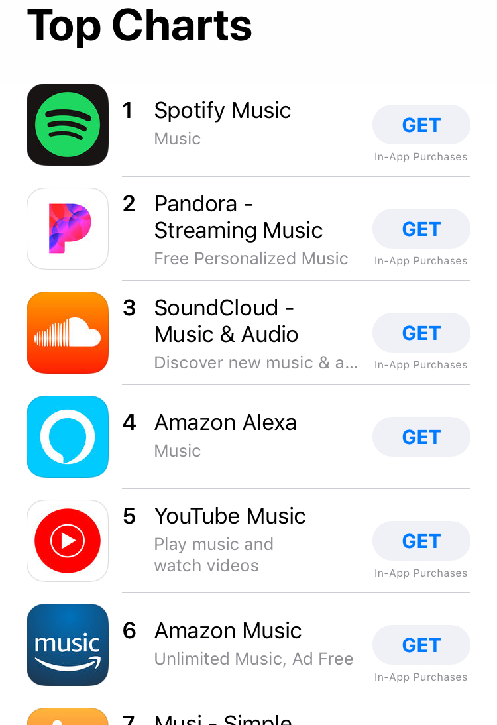
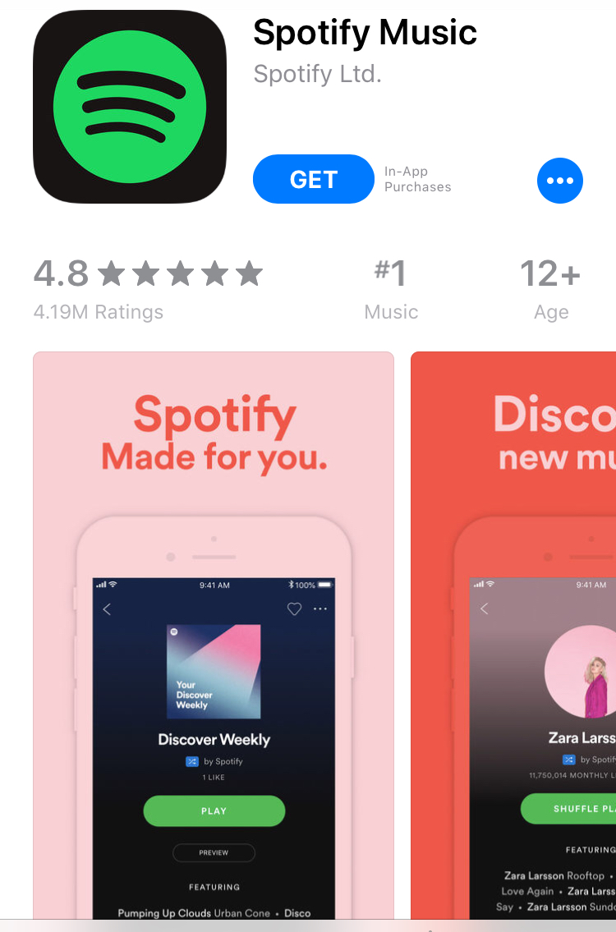
Why Spotify?

Slide 6
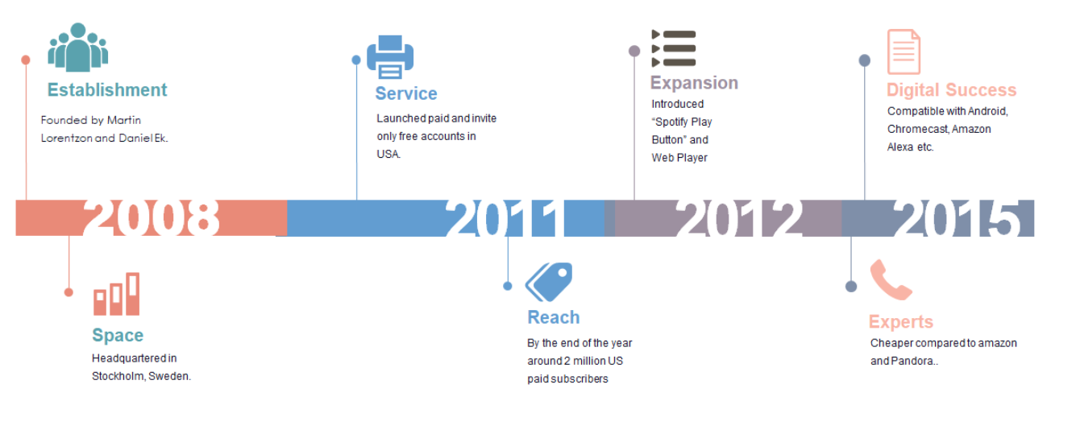
Spotify Timeline

Slide 7
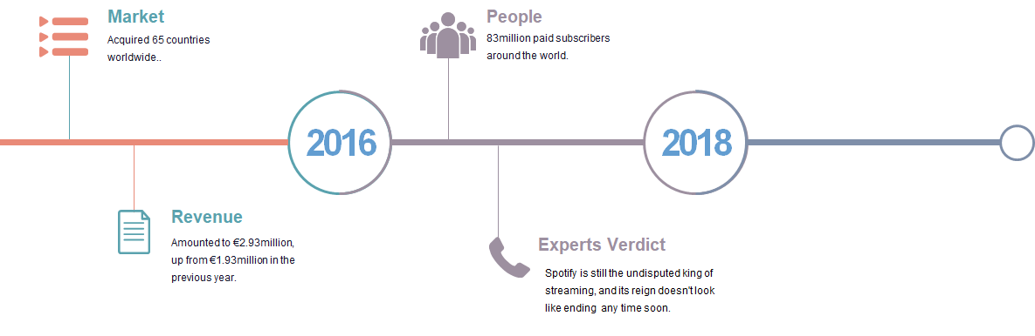
Contd…

Slide 8
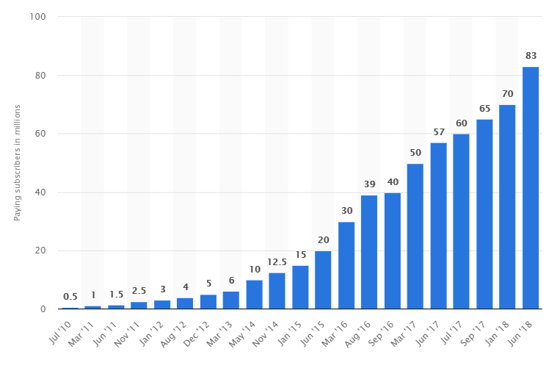
Number of paying Spotify subscribers worldwide

Slide 9
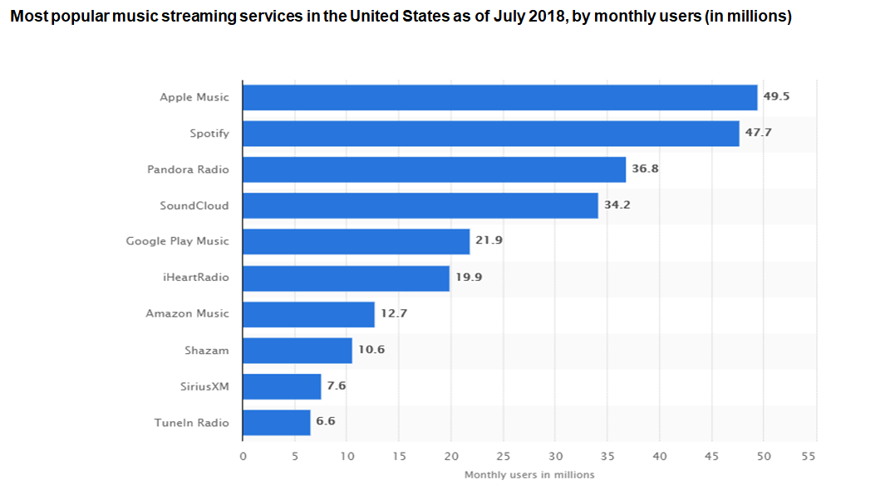
Popular Streaming Service in US

Slide 10
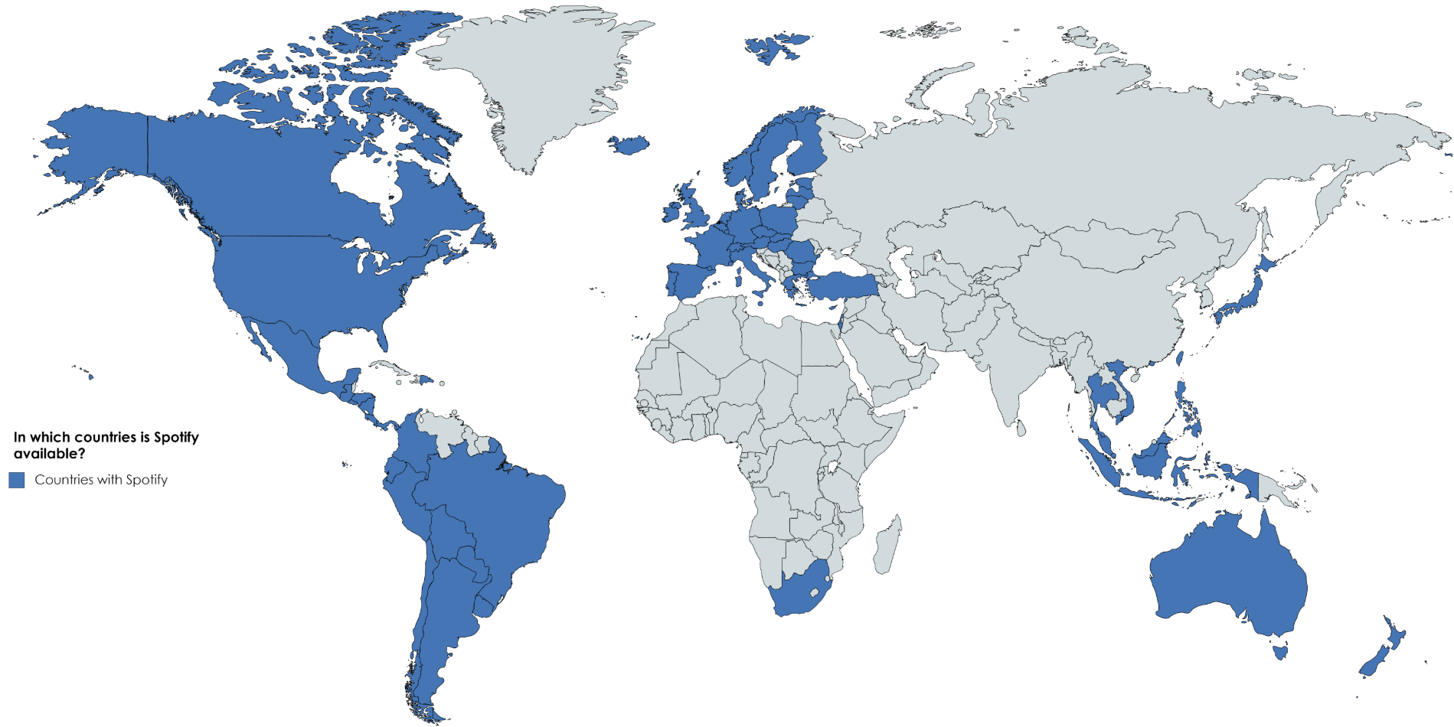
Markets Acquired

Slide 11
Methodology
LOADING DATA Insert Spotify reviews into R studio Load ‘tidytext’, ‘dply’, ‘wordcolud’ packages
1
PROCESSING&CLEANING Tokenize the sentence, remove the stop words Select Lexicons and score each review Classified each review into negative, neutral and positive.
2
3
UNDERSTANDING&ANALYZING Using the wordcloud to generate linguistic features Choosing the effected keywords as slogans
4
COMBINED WITH OTHER DATA Using the google trends to get popular features or celebrities as advertising actors We can also use the Hashtags trend to get trendy things in different area and localize advertising

Slide 12
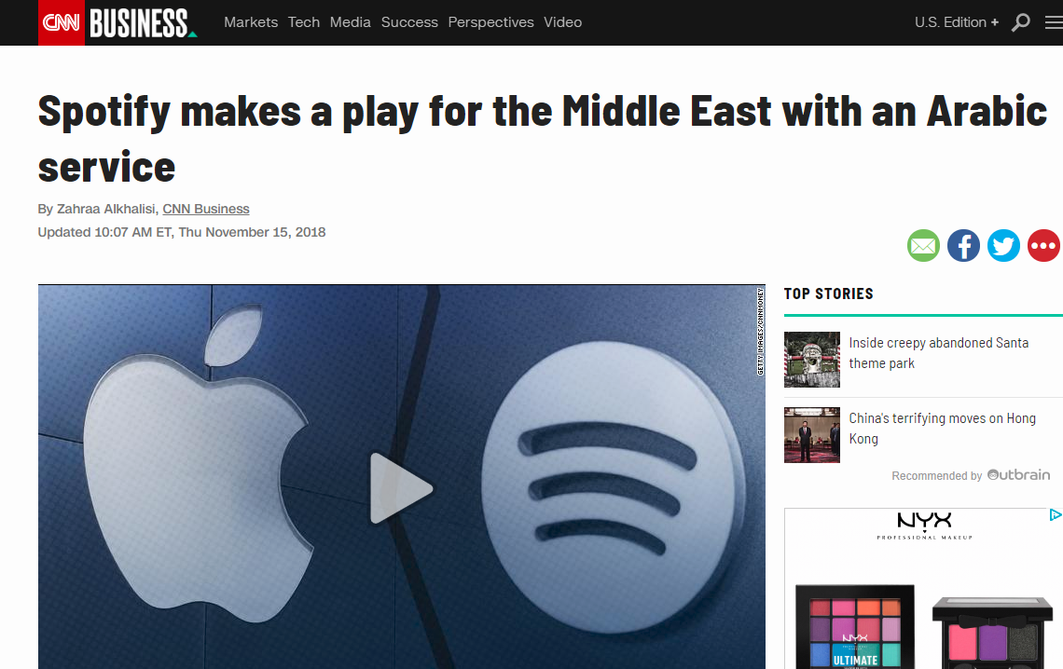

Spotify enter the Middle East

Slide 13
Text Mining Process
Positive
User Comments
1
2
3
4
Negative
3
Neutral
Afinn
Tokenization
Stemming
words
Transformation
NRC
Bing

Slide 14
Contd..
List of positive, Negative & neutral words compared again with the Lexicons for scoring
Based on the scoring, each comment’s weightage and judgement (+ve/-ve) is calculated
Common positive and negative comments are filtered
Tokenization and Term Matrix
Afinn Score
Comments
Afinn +ve/-ve
Words
Frequency
Afinn +ve/-ve
Bing +ve/-ve
NRC +ve/-ve
Pos/Neg/Neu
NRC +ve/-ve
Bing +ve/-ve
NRC Score
Bing Score
5
6
7
8

Slide 15
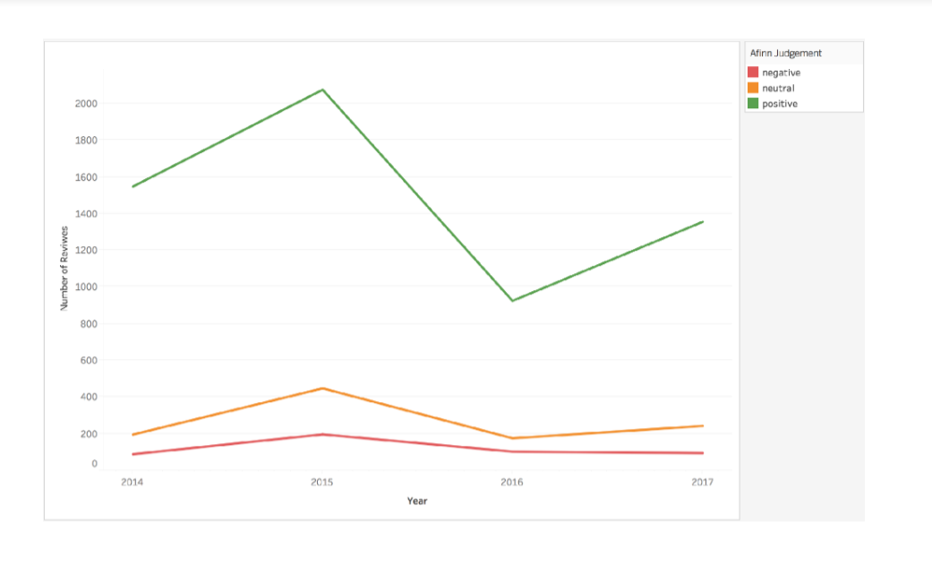
Plots

Slide 16
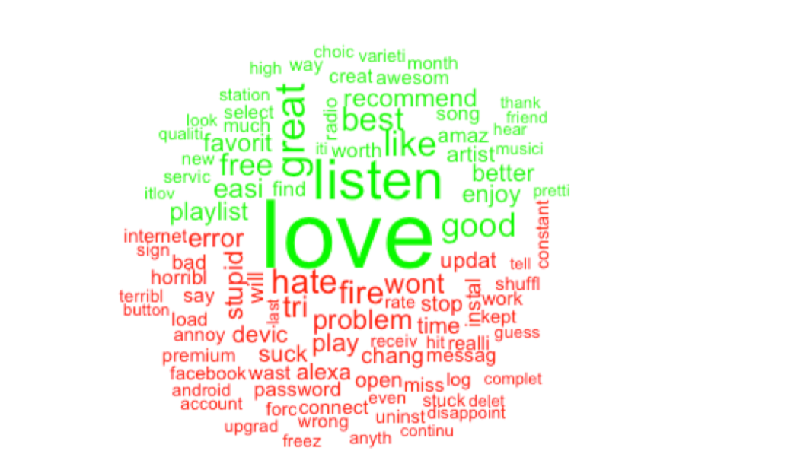
Analysis WordCloud
Most Repetitive words can be used as a selling point
Positive Words
Analyze for any technical or business issue
Negative Words

Slide 17
Word Association Iceberg
Free App
Better Pandora
Without Wifi
Spotify much
Ad
Way
Listen Music
Love

Slide 18
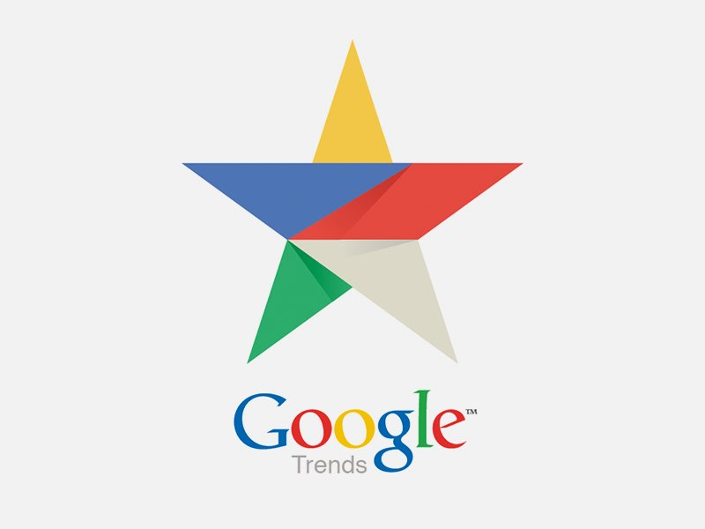
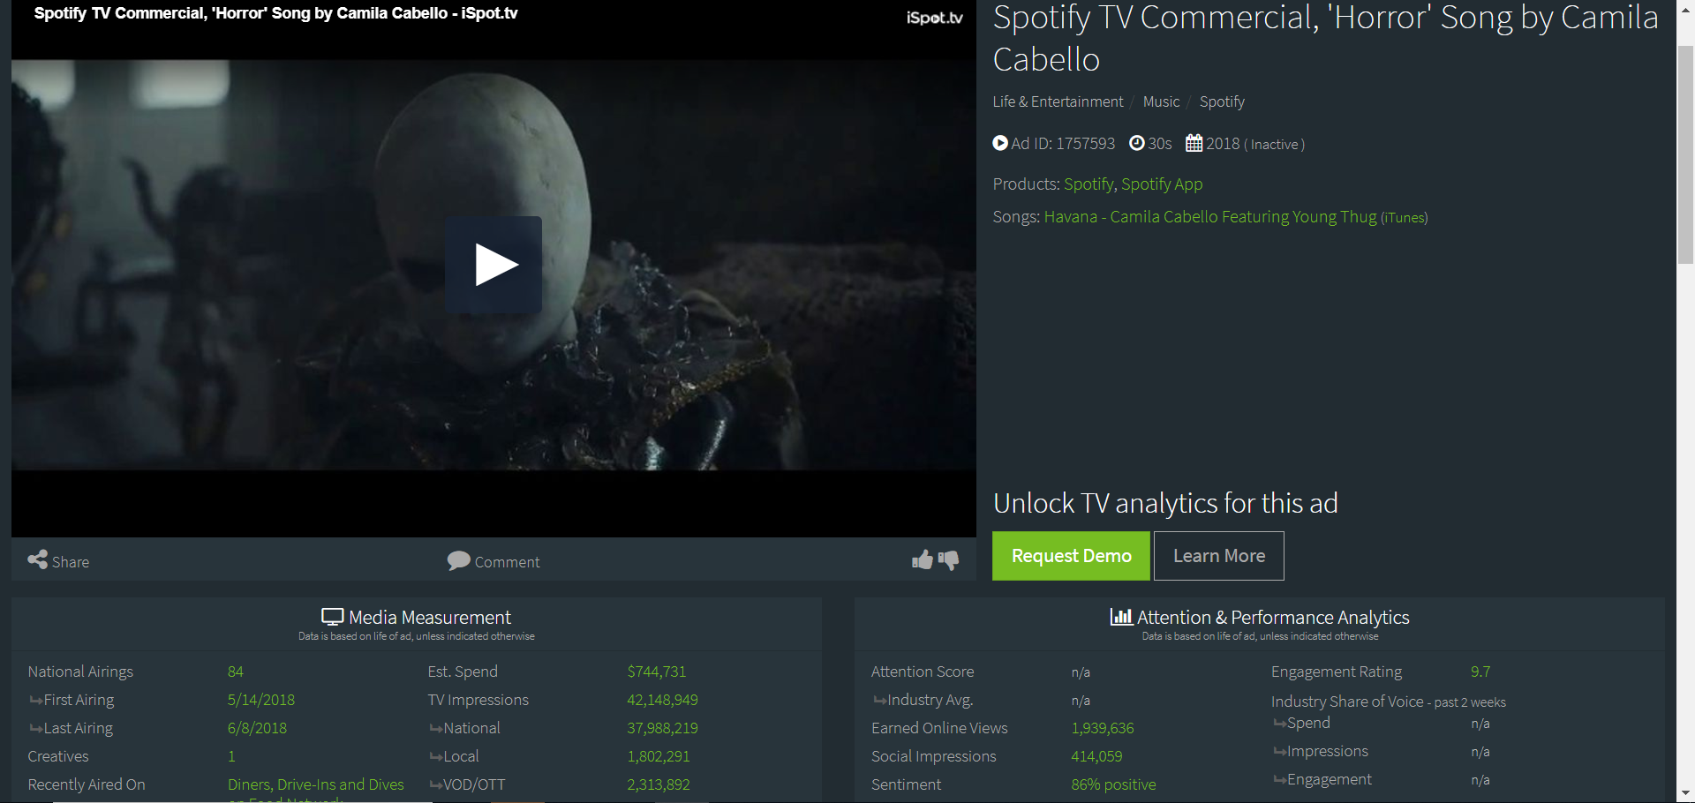
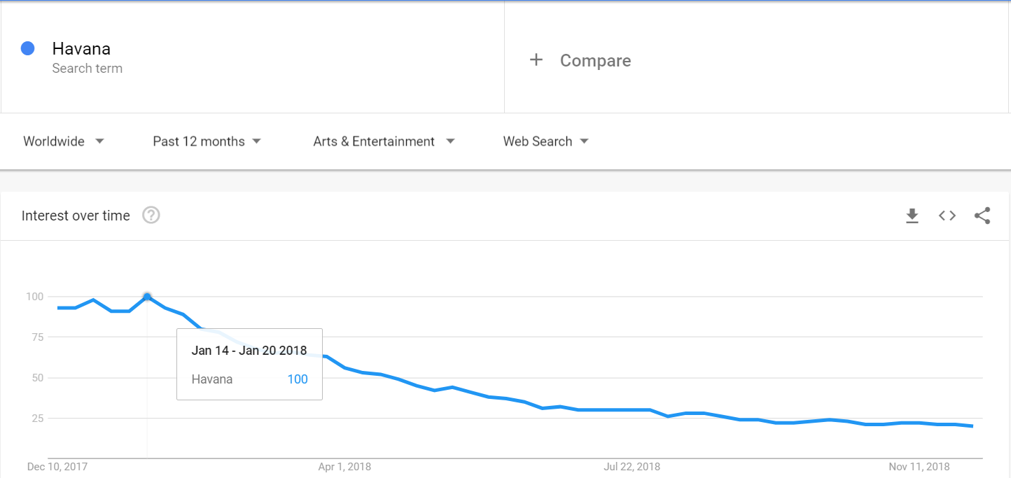
Google Trend& TV Commercial

Slide 19
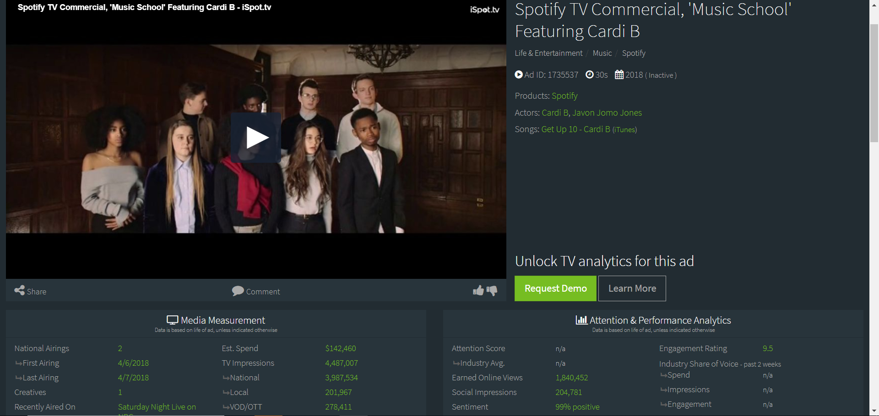
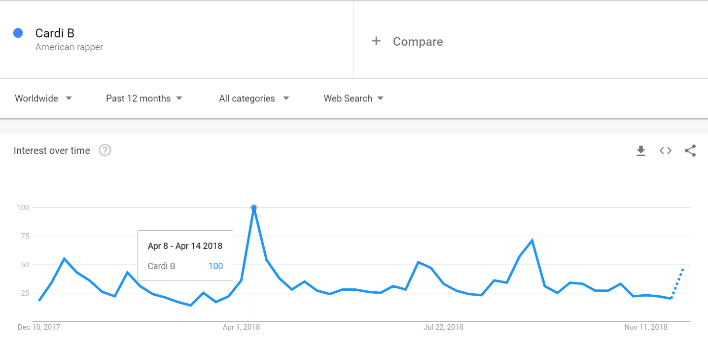
Contd..

Slide 20
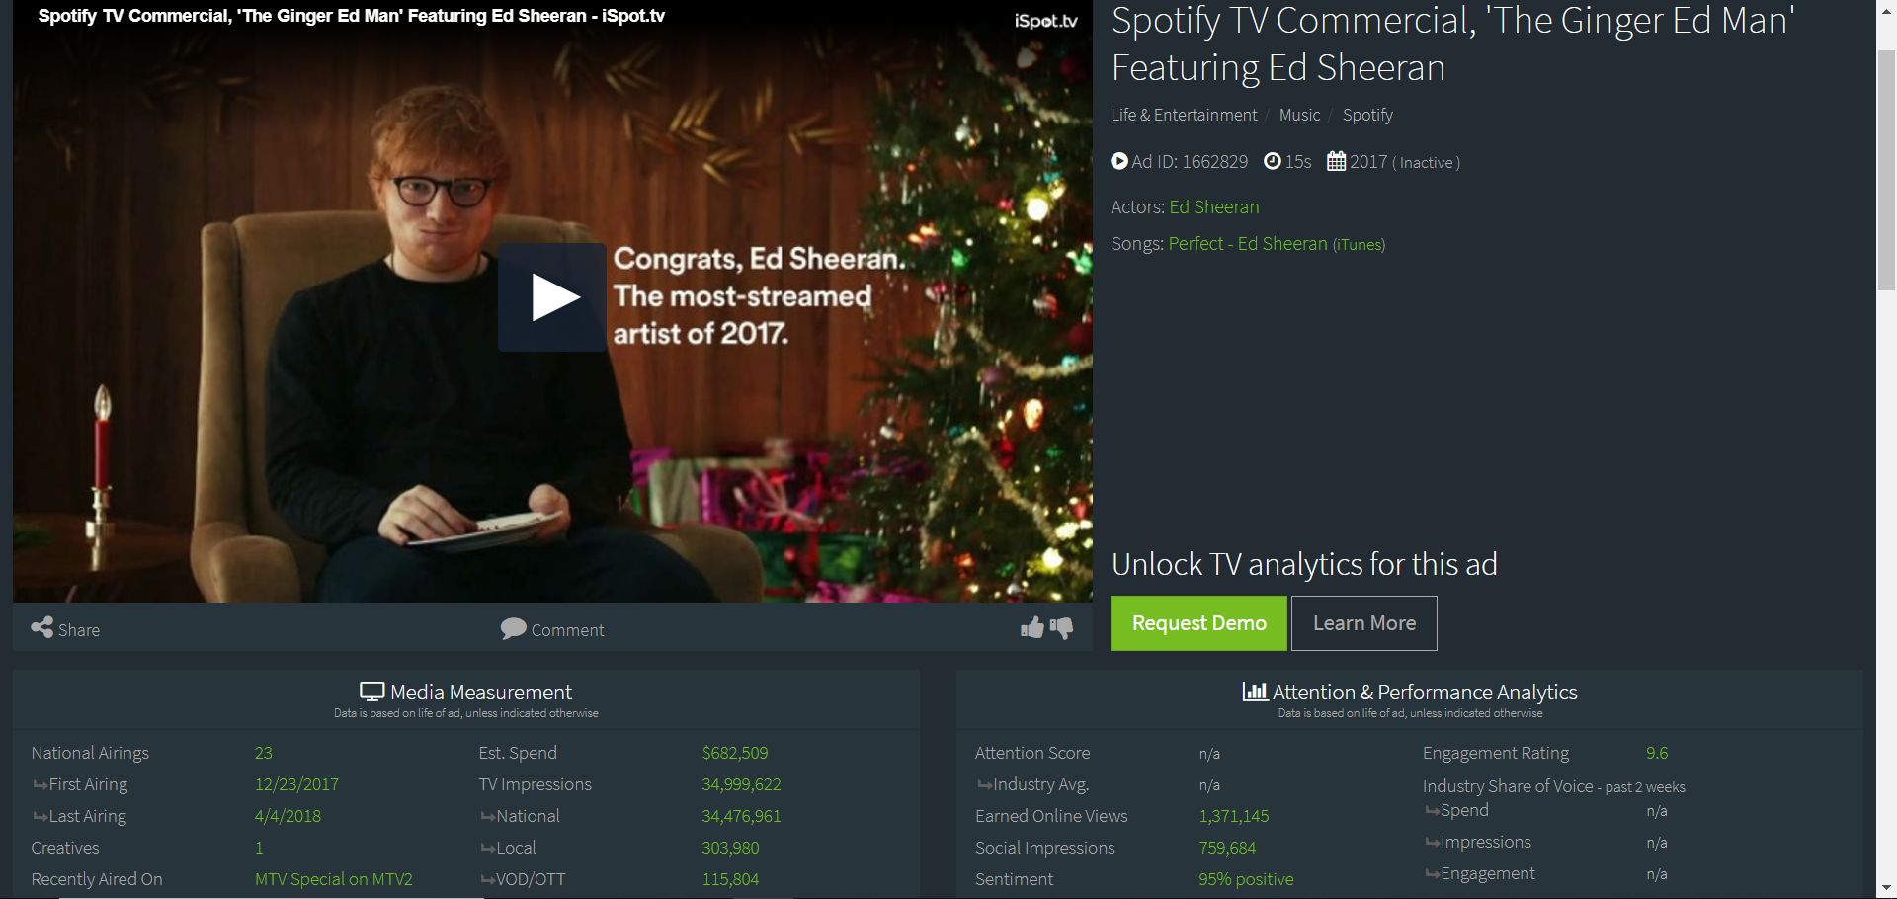
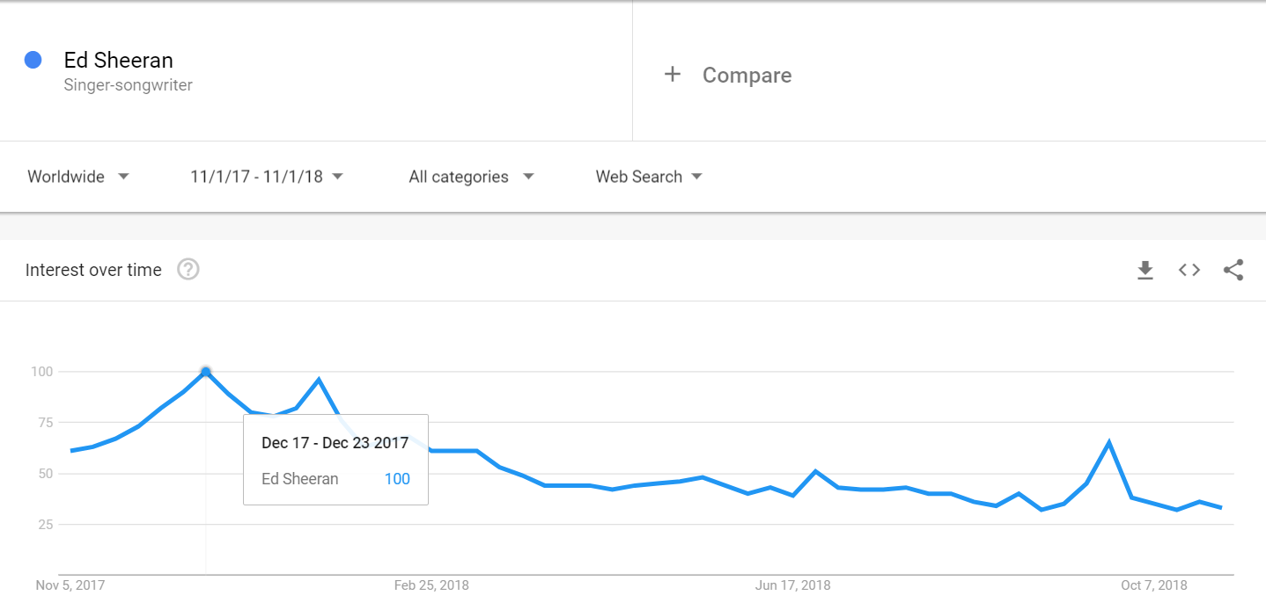
Contd..

Slide 21
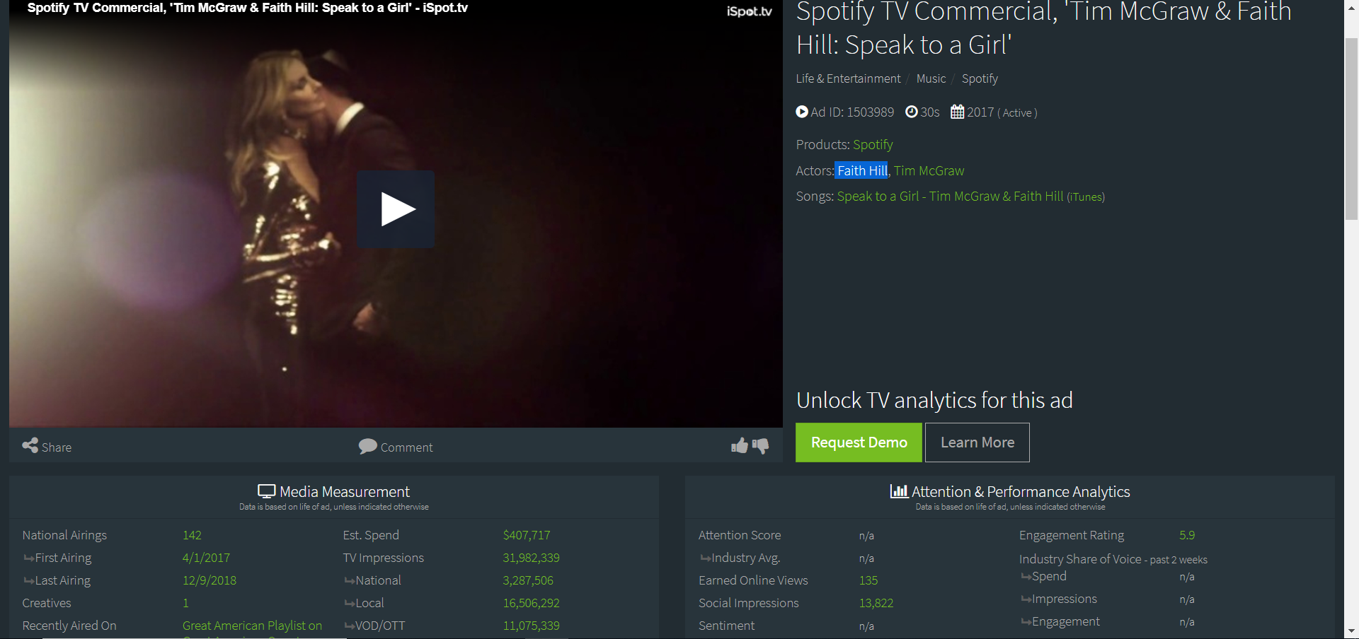
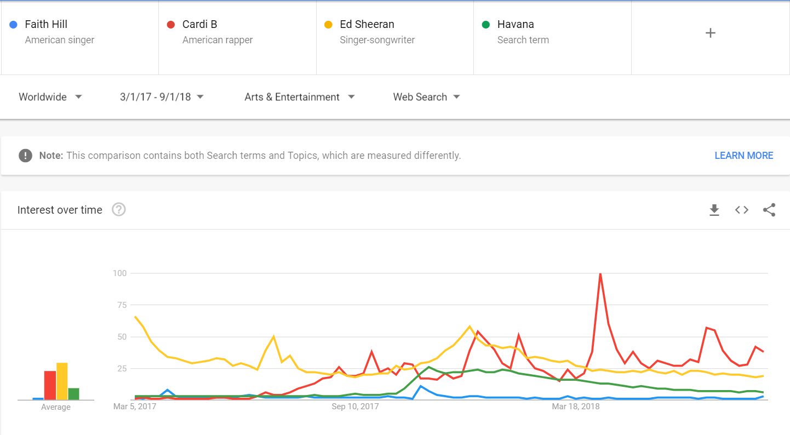
Contd..

Slide 22




Great ideas
Engagement Rates
Hashtags Trends
Ads
Google Trends

Slide 23




Brand portfolio
Hashtags Trends
Google Trends
Engagement Rates
Slogans
Advertisement
Celebrity

Slide 24
Limitations
Can’t deal with complex sentences (i.e. irony, humor, sarcasm)
Question statements
Emojis
Different dictionaries have different results
Availability of data for comparisons

Slide 25
Q&A
THANK YOU

Slide 26
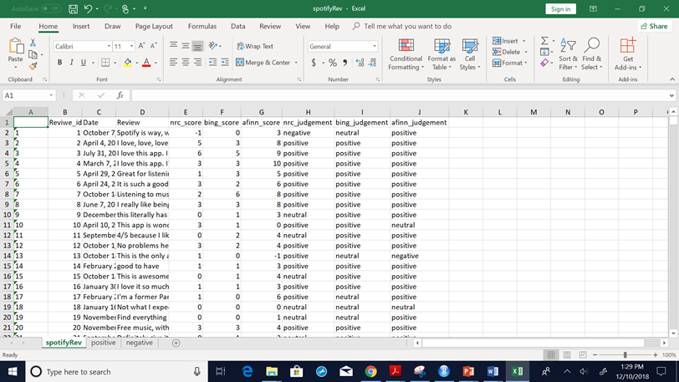
Appendix 1 - Spotify comments score and Judgement

Slide 27
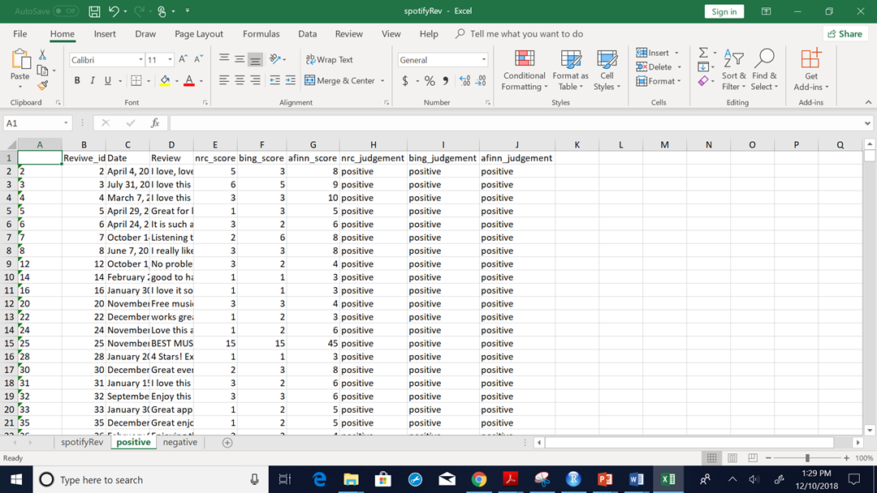
Appendix 2 - Positive Spotify comments

Slide 28
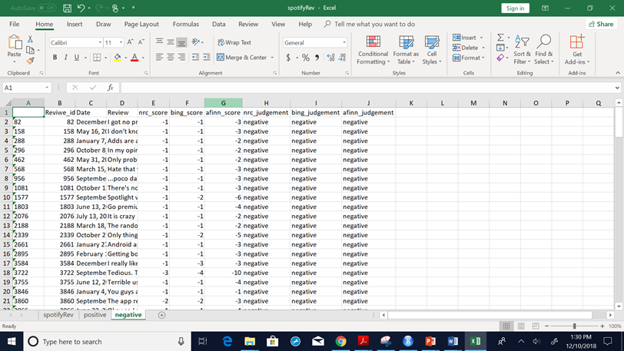
Appendix 3 - Negative Spotify comments

Slide 29
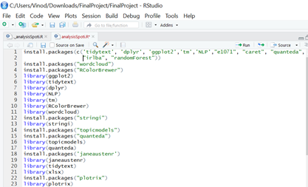
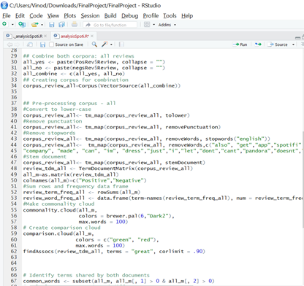
Appendix 4 - Text Mining Packages and process

Slide 30
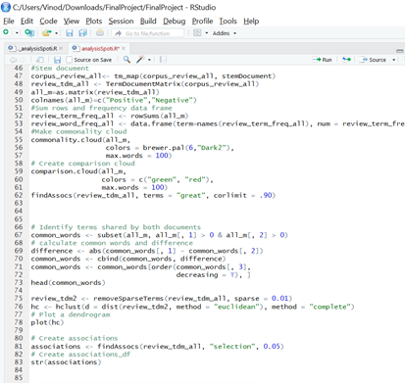
Appendix 5 - Comparison Cloud and word association

